Slide 1


Igor Andrade
June 2025

Slide 2

Outline
Executive Summary
Introduction
Methodology
Results
Conclusion
Appendix

Slide 3
Executive Summary
Summary of methodologies
Summary of all results

Slide 4
Introduction
Project background and context
Problems you want to find answers

Slide 5

Section 1

Slide 6
Methodology
Executive Summary
Data collection methodology:
Spacex API
Web Scrapping
Perform data wrangling
Clear data with Pandas
Perform exploratory data analysis (EDA) using visualization and SQL
Perform interactive visual analytics using Folium and Plotly Dash
Perform predictive analysis using classification models
Avaliate Logistic Regression, SVM, Decision Tree and K-Means

Slide 7
Data Collection
The data was collected via SpaceX API calls, with the Python requests library and Web Scrapping, using requests and BeaufiulSoup libraries.
For the SpaceX API provided the history of launches and its information;
The Web Scrapping was used to access the Falcon 9 Wiki page and get complementary information about the rockets.

Slide 8
Data Collection – SpaceX API
First, the rocket launch history was gathered by launches endpoint;
The rockets, launchpads, payloads, and cores data foreign keys from other endpoints, so helper functions were created to make these API calls and complete the data with meaningful content.
SpaceX API calls Notebook
Spacex API
launches
launches
rockets
launchpads
payloads
cores
launches
lunches

Slide 9
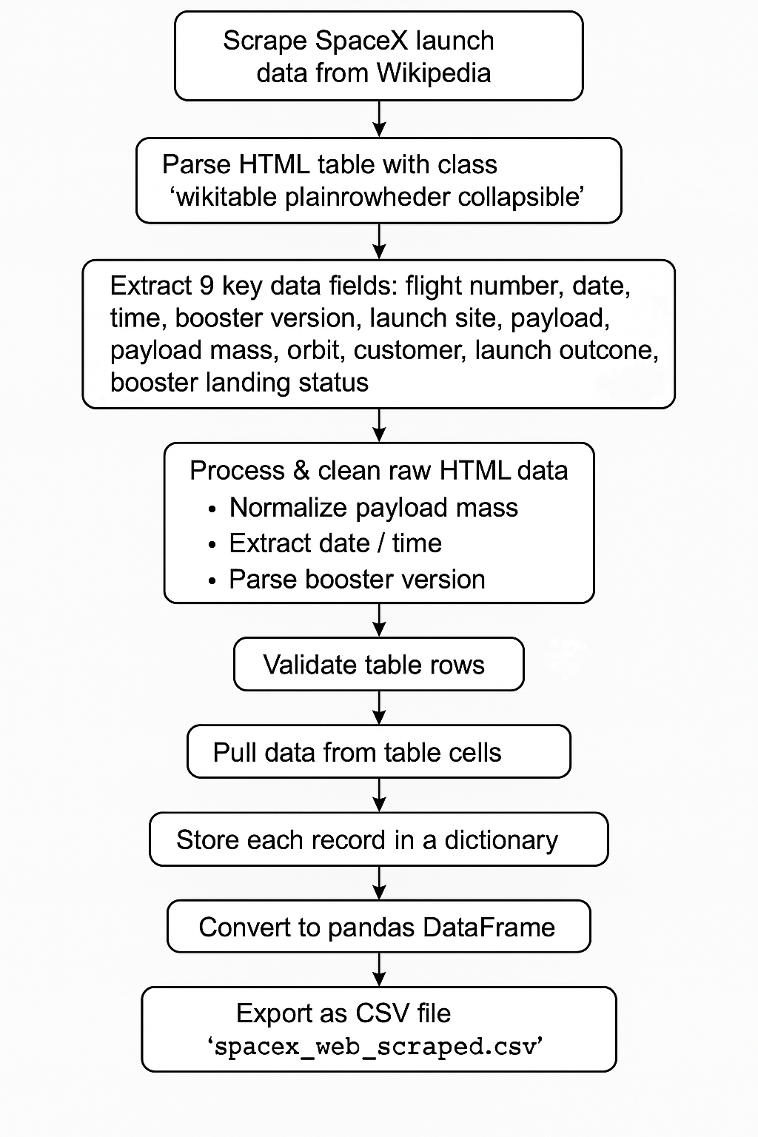
Data Collection - Scraping
The script scrapes SpaceX launch data from Wikipedia tables, validates rows by numeric flight numbers, and extracts 9 fields per launch using helper functions. It stores data in a dictionary structure and exports to CSV.
Scrapping Notebook

Slide 10
Data Wrangling
Data Loading: Load SpaceX dataset and display first rows.
Data Quality: Check missing values percentage and data types.
Exploratory Analysis: Examine launch sites, orbits, and landing outcomes.
Binary Classification: Map bad outcomes to 0 (failed) and others to 1 (success).
Results: Calculate success rate and export cleaned dataset.
Outcome: Transform raw data into binary classification format for ML.
Data Wranglign Notebook

Slide 11
EDA with Data Visualization
Setup: Import pandas, numpy, matplotlib, seaborn for analysis and plotting.
Data Loading: Download SpaceX dataset from URL and load into dataframe.
Flight Plots: Visualize payload vs flight number and launch sites vs flight number by success.
Site Analysis: Plot launch sites vs payload mass to identify success patterns.
Orbit Analysis: Create success rate bar chart by orbit and scatter plots of orbit relationships.
Time Analysis: Extract plot success rate trends over time.
Feature Engineering: Select features and apply one-hot encoding to categorical variables.
EDA with Visualization Notebook

Slide 12
EDA with SQL
Setup: Load SQL extension and connect to SQLite database.
Data Import: Load SpaceX CSV from URL into SQL table.
Basic Queries: Find distinct launch sites and filter by site patterns.
Aggregations: Sum NASA CRS payload and average F9 v1.1 payload.
Analysis: Find first successful landing and specific payload ranges.
Outcomes: Count mission outcomes and find maximum payload booster.
Temporal: Extract failure details by date and analyze landing outcomes.
Result: SQL exploration of SpaceX launch data patterns.
EDA with SQL Notebook

Slide 13
Build an Interactive Map with Folium
Map Objects Created:
Orange Circles (1500m radius) around each launch site
Orange Text Markers showing launch site names
Clustered Markers (green=success, red=failure) for all launches
Distance Markers showing KM to coastline, city, highways, railway
Polylines connecting launch sites to nearby landmarks
Purpose:
Circles & Site Markers: Identify launch locations
Color-coded Clusters: Visualize success/failure patterns
Distance Markers & Lines: Analyze proximity to infrastructure
Mouse Position: Enable precise coordinate analysis
Mouse Position Widget for coordinate trackingAdd the GitHub URL of your completed interactive map with Folium map, as an external reference and peer-review purpose
Map Notebook

Slide 14
Build a Dashboard with Plotly Dash
Dashboard Summary
Plots/Graphs:
Pie Chart - Success rates by site or aggregated across all sites
Scatter Plot - Payload mass vs success, colored by booster version
Interactive Components:
Site Dropdown - Filter by specific launch site or view all sites
Payload Range Slider - Filter data by payload mass (0-10,000 kg)
Purpose:
Pie Chart: Compare success rates between sites and overall performance
Scatter Plot: Analyze payload weight impact on success with booster technology context
Dropdown: Focus analysis on specific sites or view aggregate trends
Slider: Filter by payload ranges to identify weight-related success patterns
Dash Code

Slide 15
Predictive Analysis (Classification)
Data Prep:
Load features & target, apply StandardScaler, train/test split
Models & Hyperparameters:
Logistic Regression: C values, L2 penalty
SVM: Kernels, C, gamma parameters
Decision Tree: Criterion, depth, samples
KNN: Neighbors, algorithms, distance
Process:
GridSearchCV with 10-fold CV for each model
Evaluate with accuracy scores and confusion matrices
Result: Compare all models to select best performer for SpaceX landing predictionAdd the GitHub URL of your completed predictive analysis lab, as an external reference and peer-review purpose
Analysis Notebook

Slide 16

Section 2

Slide 17
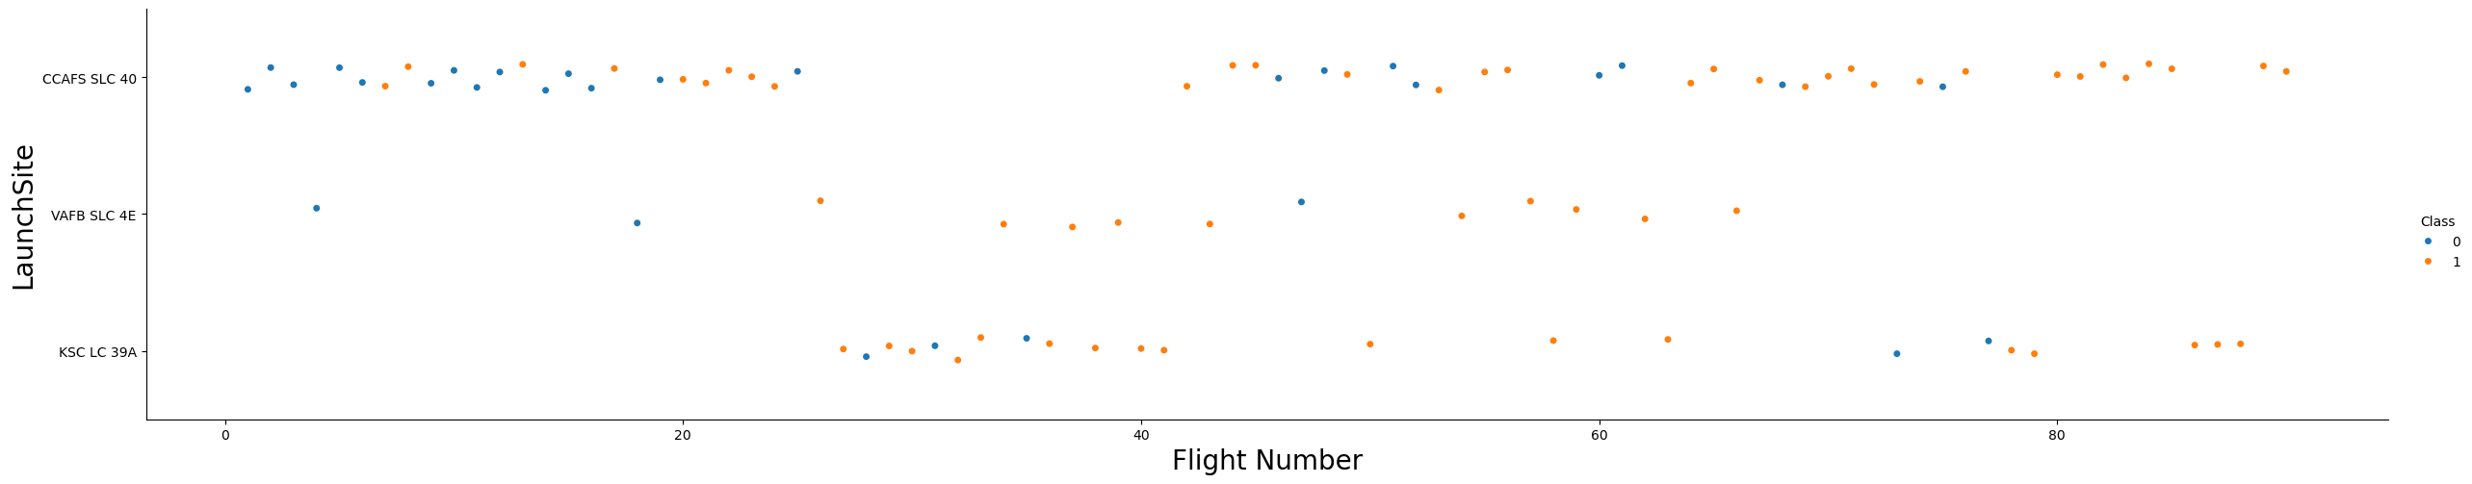
Flight Number vs. Launch Site
Chart demonstrates SpaceX's technological maturation from experimental failures to reliable operations, with newer facilities benefiting from accumulated knowledge and advanced systems.

Slide 18
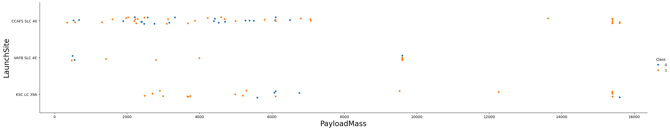
Payload vs. Launch Site
Different launch sites handle varying payload ranges, with KSC LC-39A typically managing heavier payloads and showing higher success rates, suggesting site-specific optimization.

Slide 19
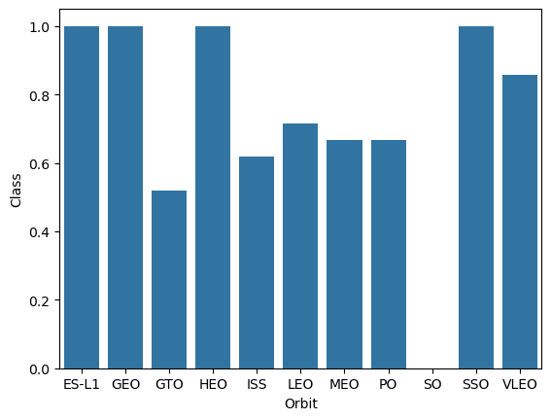
Success Rate vs. Orbit Type
Certain orbit types demonstrate significantly higher landing success rates, indicating that mission profile and orbital mechanics directly impact recovery feasibility.

Slide 20
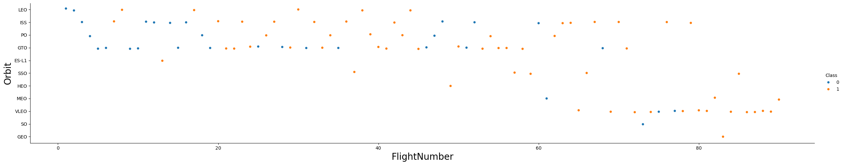
Flight Number vs. Orbit Type
Mission complexity and orbit selection evolved over time, with later flights targeting more diverse orbits while maintaining improved success rates through technological advancement.

Slide 21
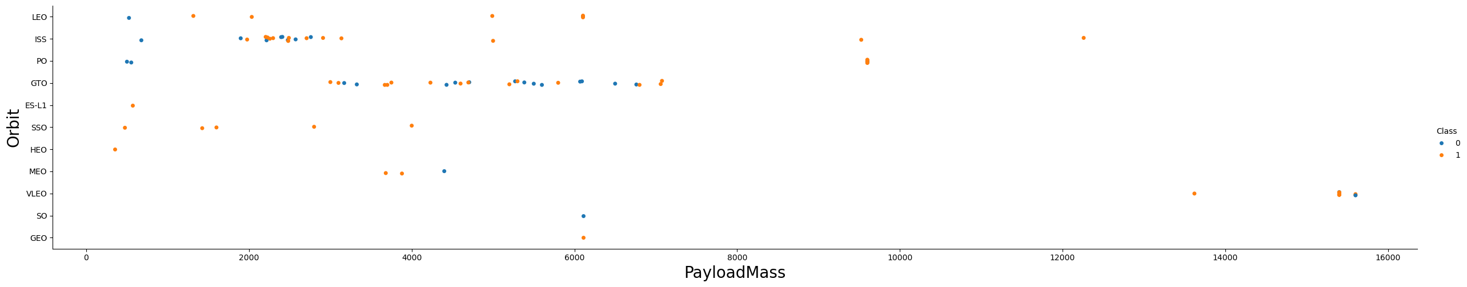
Payload vs. Orbit Type
Specific orbit-payload combinations show distinct success patterns, revealing optimal operational parameters for successful first-stage recovery based on mission requirements

Slide 22
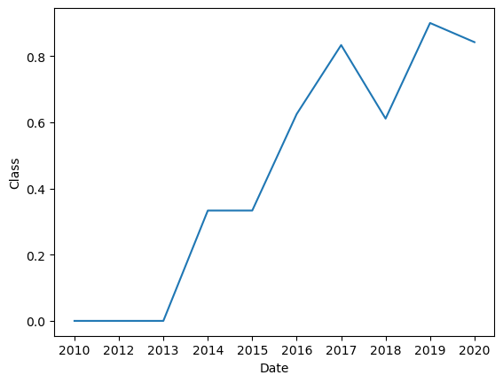
Launch Success Yearly Trend
Clear upward trend demonstrates SpaceX's rapid learning curve and systematic improvement, with success rates dramatically increasing from early experimental phases to current operational excellence.

Slide 23
All Launch Site Names
The unique Launch Sites:
Cape Canaveral LC-40, Cape Canaveral SLC-40, CCAFS SLC-40, KSC LC-39A, VAFB SLC-4E

Slide 24
Launch Site Names Begin with 'CCA'
Find 5 records where launch sites begin with `CCA`
Present your query result with a short explanation here

Slide 25
Total Payload Mass
Calculate the total payload carried by boosters from NASA
Present your query result with a short explanation here

Slide 26
Average Payload Mass by F9 v1.1
Calculate the average payload mass carried by booster version F9 v1.1
Present your query result with a short explanation here

Slide 27
First Successful Ground Landing Date
Find the dates of the first successful landing outcome on ground pad
Present your query result with a short explanation here

Slide 28
Successful Drone Ship Landing with Payload between 4000 and 6000
List the names of boosters which have successfully landed on drone ship and had payload mass greater than 4000 but less than 6000
Present your query result with a short explanation here

Slide 29
Total Number of Successful and Failure Mission Outcomes
Calculate the total number of successful and failure mission outcomes
Present your query result with a short explanation here

Slide 30
Boosters Carried Maximum Payload
List the names of the booster which have carried the maximum payload mass
Present your query result with a short explanation here

Slide 31
2015 Launch Records
List the failed landing_outcomes in drone ship, their booster versions, and launch site names for in year 2015
Present your query result with a short explanation here

Slide 32
Rank Landing Outcomes Between 2010-06-04 and 2017-03-20
Rank the count of landing outcomes (such as Failure (drone ship) or Success (ground pad)) between the date 2010-06-04 and 2017-03-20, in descending order
Present your query result with a short explanation here

Slide 33

Section 3

Slide 34
<Folium Map Screenshot 1>
Replace <Folium map screenshot 1> title with an appropriate title
Explore the generated folium map and make a proper screenshot to include all launch sites’ location markers on a global map
Explain the important elements and findings on the screenshot

Slide 35
<Folium Map Screenshot 2>
Replace <Folium map screenshot 2> title with an appropriate title
Explore the folium map and make a proper screenshot to show the color-labeled launch outcomes on the map
Explain the important elements and findings on the screenshot

Slide 36
<Folium Map Screenshot 3>
Replace <Folium map screenshot 3> title with an appropriate title
Explore the generated folium map and show the screenshot of a selected launch site to its proximities such as railway, highway, coastline, with distance calculated and displayed
Explain the important elements and findings on the screenshot

Slide 37

Section 4

Slide 38
<Dashboard Screenshot 1>
Replace <Dashboard screenshot 1> title with an appropriate title
Show the screenshot of launch success count for all sites, in a piechart
Explain the important elements and findings on the screenshot

Slide 39
<Dashboard Screenshot 2>
Replace <Dashboard screenshot 2> title with an appropriate title
Show the screenshot of the piechart for the launch site with highest launch success ratio
Explain the important elements and findings on the screenshot

Slide 40
<Dashboard Screenshot 3>
Replace <Dashboard screenshot 3> title with an appropriate title
Show screenshots of Payload vs. Launch Outcome scatter plot for all sites, with different payload selected in the range slider
Explain the important elements and findings on the screenshot, such as which payload range or booster version have the largest success rate, etc.

Slide 41

Section 5

Slide 42
Classification Accuracy
Visualize the built model accuracy for all built classification models, in a bar chart
Find which model has the highest classification accuracy

Slide 43
Confusion Matrix
Show the confusion matrix of the best performing model with an explanation

Slide 44
Conclusions
Point 1
Point 2
Point 3
Point 4
…

Slide 45
Appendix
Include any relevant assets like Python code snippets, SQL queries, charts, Notebook outputs, or data sets that you may have created during this project

Slide 46


